Slide 1

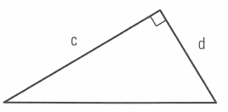

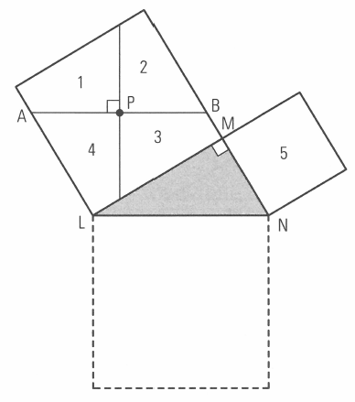


Investigating Pythagoras’ Theorum
M
L
N

Slide 2
But what does it mean?!
For a right-angled triangle, the area of the squares formed by the shorter sides should equal the area of the square formed by the longer side
Given that the area of a square is calculated by the length squared (AoS = L²), we could also conclude that the length of the shorter sides squared and then added together is equal to longer side squared (L1² + L2² = L2³)

Slide 3
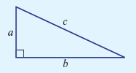
And a little more clearly?
To summarise:
a² + b² = c²
shorter sides longer side (hypotenuse)

Slide 4
Prove it!
On your Graph Paper, draw a Right Angled Triangle. Pick whole numbers as your lengths if possible (3, 4, 5 is an example but there are plenty more). Draw the square of each side and label it. Count each of the squares of sides A and B. Does their sum match the square of side C, the hypotenuse?
Cut your diagram out and paste it into your Task Page.

Slide 5
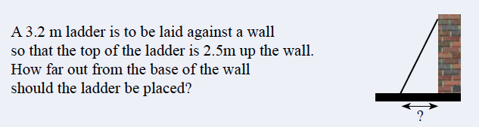
Starter

Slide 6

Pythagoras’ Theorem
Learning Objectives:
Be able to label a right angled triangle
Be able to use Pythagoras to find the
hypotenuse
Able to apply to worded problems
What would be the EQ? Write it!

Slide 7
Pythagoras’ Theorem
KEY WORD: Hypotenuse:
The longest side on a right angled triangle
Found opposite the right angle

Slide 8
Pythagoras’ Theorem
c
hypotenuse
hypotenuse
m
p
hypotenuse
c
a
b
b
a
d
Which of these sides is the hypotenuse?

Slide 9
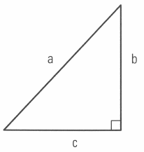
What’s our formula again?
Pythagoras’ theorem for this triangle is:
a² + b² = c²
shorter sides longer side
But the letters just represent numbers. They can be switched around!
For this triangle, the formula
would be c² + b² = a²

Slide 10
Write pythagoras’ theorem for these triangles?
a
c
a
c
b
b
10cm
6cm
8cm

Slide 11




Now to use this formula
Find the length of the hypotenuse for these:
a) b)

Slide 12
Pythagoras’ Theorem
https://www.youtube.com/watch?v=CAkMUdeB06o
https://www.youtube.com/watch?v=uaj0XcLtN5c&t=1s

Slide 13
Pythagoras’ Theorem
Learning Objectives:
Be able to label a right angled triangle
Be able to use Pythagoras to find the
hypotenuse
Able to apply to worded problems

Slide 14
Pythagoras’ Theorem
Exercise 7-2, page 91
Q1 – 6
Sketch the triangles and show your working out

Slide 15
Plenary
A plane flies due north for 180km, then due west for 260km. How far is the plane from it’s starting position?
  Draw and label a triangle to represent the situation
  Write out the formula you’d use to answer the question
  Find the distance

